Slide 1
COA: Memory Hierarchy

Slide 2
Question [GATE 2009]
Increasing the RAM of a computer typically improves performance because: (A) Virtual memory increases (B) Larger RAMs are faster (C) Fewer page faults occur (D) Fewer segmentation faults occur

Slide 3
Answer: (C)
Explanation: When RAM size is bigger, the page table would have more entries of pages, hence less number of page faults.

Slide 4
Question: [GATE 2009]
How many 32K x 1 RAM chips are needed to provide a memory capacity of 256K-bytes? (A) 8 (B) 32 (C) 64 (D) 128

Slide 5
Answer: (C)
Explanation:
We need 256 Kbytes, i.e., 256 x 1024 x 8 bits. We have RAM chips of capacity 32 Kbits = 32 x 1024 bits. (256 * 1024 * 8)/(32 * 1024) = 64

Slide 6
Question: [GATE 2010]
A main memory unit with a capacity of 4 megabytes is built using 1M × 1-bit DRAM chips. Each DRAM chip has 1K rows of cells with 1K cells in each row. The time taken for a single refresh operation is 100 nanoseconds. The time required to perform one refresh operation on all the cells in the memory unit is:- A.100 nanoseconds B.100×2¹⁰ nanoseconds C.100×2²⁰ nanoseconds D.3200×2²⁰ nanoseconds

Slide 7
Answer: (B)
Explanation:
Number of chips required for 4MB MM = (4 * 2^20 * 8) / (1 * 2^20) = 32 chips In a refresh cycle, a whole row of a memory chip is refreshed at once. This implies the given time of 100 ns for one refresh operation refreshes one row of memory chip. Since there are 1K=2^10 such rows, time for refreshing a whole chip would be: 2^10 * 100 ns.
Second question arises, how to arrange these chips as there can be many possible arrangements. There is a logical arrangement provided in the problem statement itself as “1M x 1 bit chip”. This indicates that to make a “1M x 32 bits” MM, we need to arrange all 32 chips in a line. It is to be noted that a row in all chips in series can be refreshed in one refresh cycle. This makes the total time to refresh the 4MBytes of memory as same as that of one chip. Hence, time required to refresh MM = 100 * 2^10 ns.

Slide 8
Question: [GATE 2016 ]
A processor can support a maximum memory of 4 GB, where the memory is word-addressable (a word consists of two bytes). The size of the address bus of the processor is at ____ least bits.
(A) 16 (B) 31 (C) 32 (D) None

Slide 9
Answer: (B)
Explanation: Maximum Memory = 4GB = 2³² bytes Size of a word = 2 bytes Therefore, Number of words = 2³² / 2 = 2³¹ So, we require 31 bits for the address bus of the processor. Thus, B is the correct choice.

Slide 10
Question [GATE 2004]
What is the minimum size of ROM required to store the complete truth table of an 8-bit x 8-bit multiplier? (A) 32 K x 16 bits (B) 64 K x 16 bits (C) 16 K x 32 bits (D) 64 K x 32 bits

Slide 11
Answer: (B)
Explanation: Input to ROM – 2 lines ,8 bit each. Possible combinations in ROM – (2^8)x(2^8)
Size of truth table = (2^8)*(2^8)=2^16=64 KB
Maximum output size = 16 bit
So, Answer is B

Slide 12
Question [GATE 2012]
The amount of ROM needed to implement a 4 bit multiplier is
(A) 64 bits (B) 128 bits (C) 1 Kbits (D) 2 Kbits

Slide 13
Answer: (D)
Explanation: For a 4 bit multiplier, there are 2⁴ * 2⁴ combinations, i.e., 2⁸ combinations. Also, Output of a 4 bit multiplier is 8 bits. Thus, the amount of ROM needed = 2⁸ * 8 = 2¹¹ = 2048 bits = 2Kbits

Slide 14
Question: [GATE 2005]
A dynamic RAM has a memory cycle time of 64 nsec. It has to be refreshed 100 times per msec and each refresh takes 100 nsec. What percentage of the memory cycle time is used for refreshing? (A) 10 (B) 6.4 (C) 1 (D) 0.64

Slide 15
Answer: (C)
Explanation: Memory cycle time = 64 ns Memory is refreshed 100 times per msec. Number of refreshes in 1 memory cycle (i.e in 64 ns) = (100 * 64 * 10⁻⁹) / 10⁻³ = 64 * 10⁻⁴. Time taken for each refresh = 100 ns Time taken for 64 * 10⁻⁴ refreshes = 64 * 10⁻⁴ * 100 * 10⁻⁹ sec = 64 * 10⁻¹¹ sec. Percentage of the memory cycle time used for refreshing : = (Time taken to refresh in 1 memory cycle / Total time) * 100 = (64 * 10⁻¹¹ / 64 * 10⁻⁹) * 100 = 1 % Thus, option (C) is correct.

Slide 16
Question [GATE 2000]
A graphics card has on board memory of 1 MB. Which of the following modes can the card not support?
(A) 1600 x 400 resolution with 256 colours on a 17-inch monitor (B) 1600 x 400 resolution with 16 million colours on a 14-inch monitor (C) 800 x 400 resolution with 16 million colours on a 17-inch monitor (D) 800 x 800 resolution with 256 colours on a 14-inch monitor

Slide 17
Answer: (b)
Explanation: Monitor size doesn’t matter here. So, we can easily deduce that answer should be (b) as this has the highest memory requirements. Let us verify it. Number of bits required to store a 16M colors pixel = ceil(log2(16*1000000)) = 24 Number of bytes required for 1600 x 400 resolution with 16M colors = (1600 * 400 * 24)/8 which is 192000000 (greater than 1MB).

Slide 18
Question: [GATE 2017 ]
A cache memory unit with capacity of N words and block size of B words is to be designed. If it is designed as direct mapped cache, the length of the TAG field is 10 bits. If the cache unit is now designed as a 16-way set-associative cache, the length of the TAG field is ______ bits.
(A) 12 (B) 14 (C) 16 (D) 18

Slide 19
Answer: (B)
Explanation: Type of mapping is direct map; for this direct map, 10 bits are required in its Tag.
It is updated to 16 way set Associative map then new tag field size = 10 + log₂16 = 14 bits, because for k way set associative map design, log₂k bits are additionally required to the number of bits in tag field for Direct map design.

Slide 20
Question
Consider a machine with a byte addressable main memory of 2¹⁶ bytes. Assume that a direct mapped data cache consisting of 32 lines of 64 bytes each is used in the system. A 50 × 50 two-dimensional array of bytes is stored in the main memory starting from memory location 1100H. Assume that the data cache is initially empty. The complete array is accessed twice. Assume that the contents of the data cache do not change in between the two accesses. How many data cache misses will occur in total?
(A) 40 (B) 50 (C) 56 (D) 59

Slide 21
Answer: (C)

Slide 22
Question: [GATE 2018]
The size of the physical address space of a processor is 2^{P} bytes. The word length is 2^{W} bytes. The capacity of cache memory is 2^{N} bytes. The size of each cache block is 2^{M} words. For a K-way set-associative cache memory, the length (in number of bits) of the tag field is
(A) P − N − log₂K (B) P − N + log₂K (C) P − N − M − W − log₂K (D) P − N − M − W + log₂K

Slide 23
Answer: (B)
Explanation: Physical Address Space = 2^{P} Bytes. Word Length is 2^{W} bytes, which means each word is of size 2^{W} bytes. Cache memory size = 2^{N} Bytes and Tag Size = 2^{X} Bytes. Physical address is P – W bits Number of blocks in cache = 2^{(N-W-M)}
It is a K-way set associative cache memory, each set in cache will have K-blocks. So, Number of sets = 2^{(N-W-M)}/ K SET bits will be N-W-M-logk Offset bits will be M
We know, TAG bits = Main memory bits – SET bits – offset bits So, TAG bits(x) = P – W – (N-M-W-logk)- M = P – W – N + M + W + logk – M x = P – N + logk

Slide 24
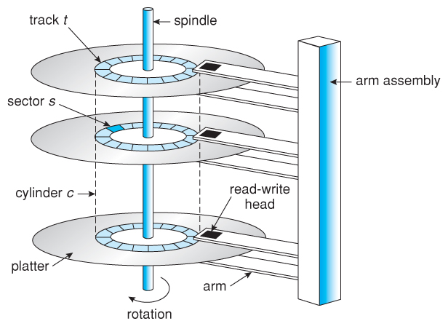
Disk

Slide 25
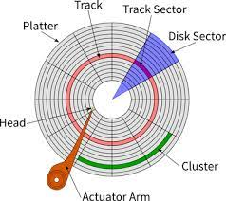
Platter’s Top View

Slide 26
Seek Time:
Rotational Latency:
Rotational Latency = ½ * rotation time
Transfer Time:
Disk Access Time: Seek Time + Rotation latency + Transfer Time + Control Overhead

Slide 27
Question
A disk pack has 19 surfaces. Storage area on each surface has an inner diameter of 22 cm and outer diameter of 33 cm. Maximum storage density on any track is 2000 bits/cm, minimum spacing between tracks is 0.25 cm.
What is the storage capacity of the pack?
What is the data transfer rate in bytes per second at a rotational speed of 3600 rpm?

Slide 28
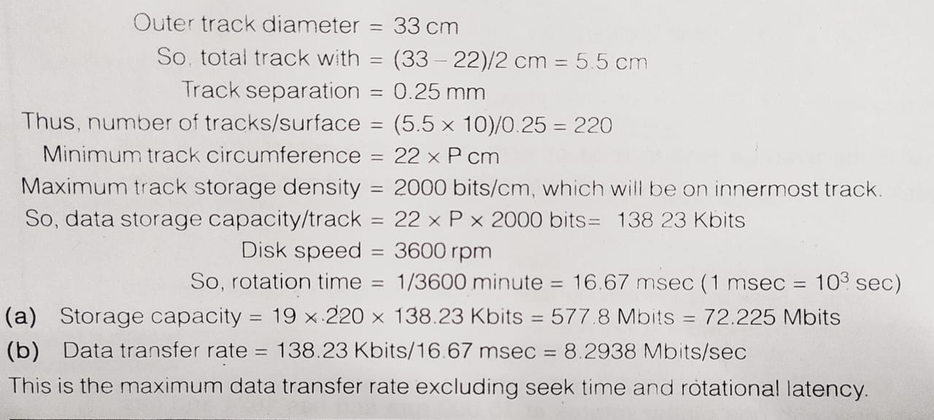

Slide 29
